Slide 1
CSI Móstoles
Nathaly Cárdenas, Iván Artalejo, Hugo Fernández, Jorge Navarro

Slide 2
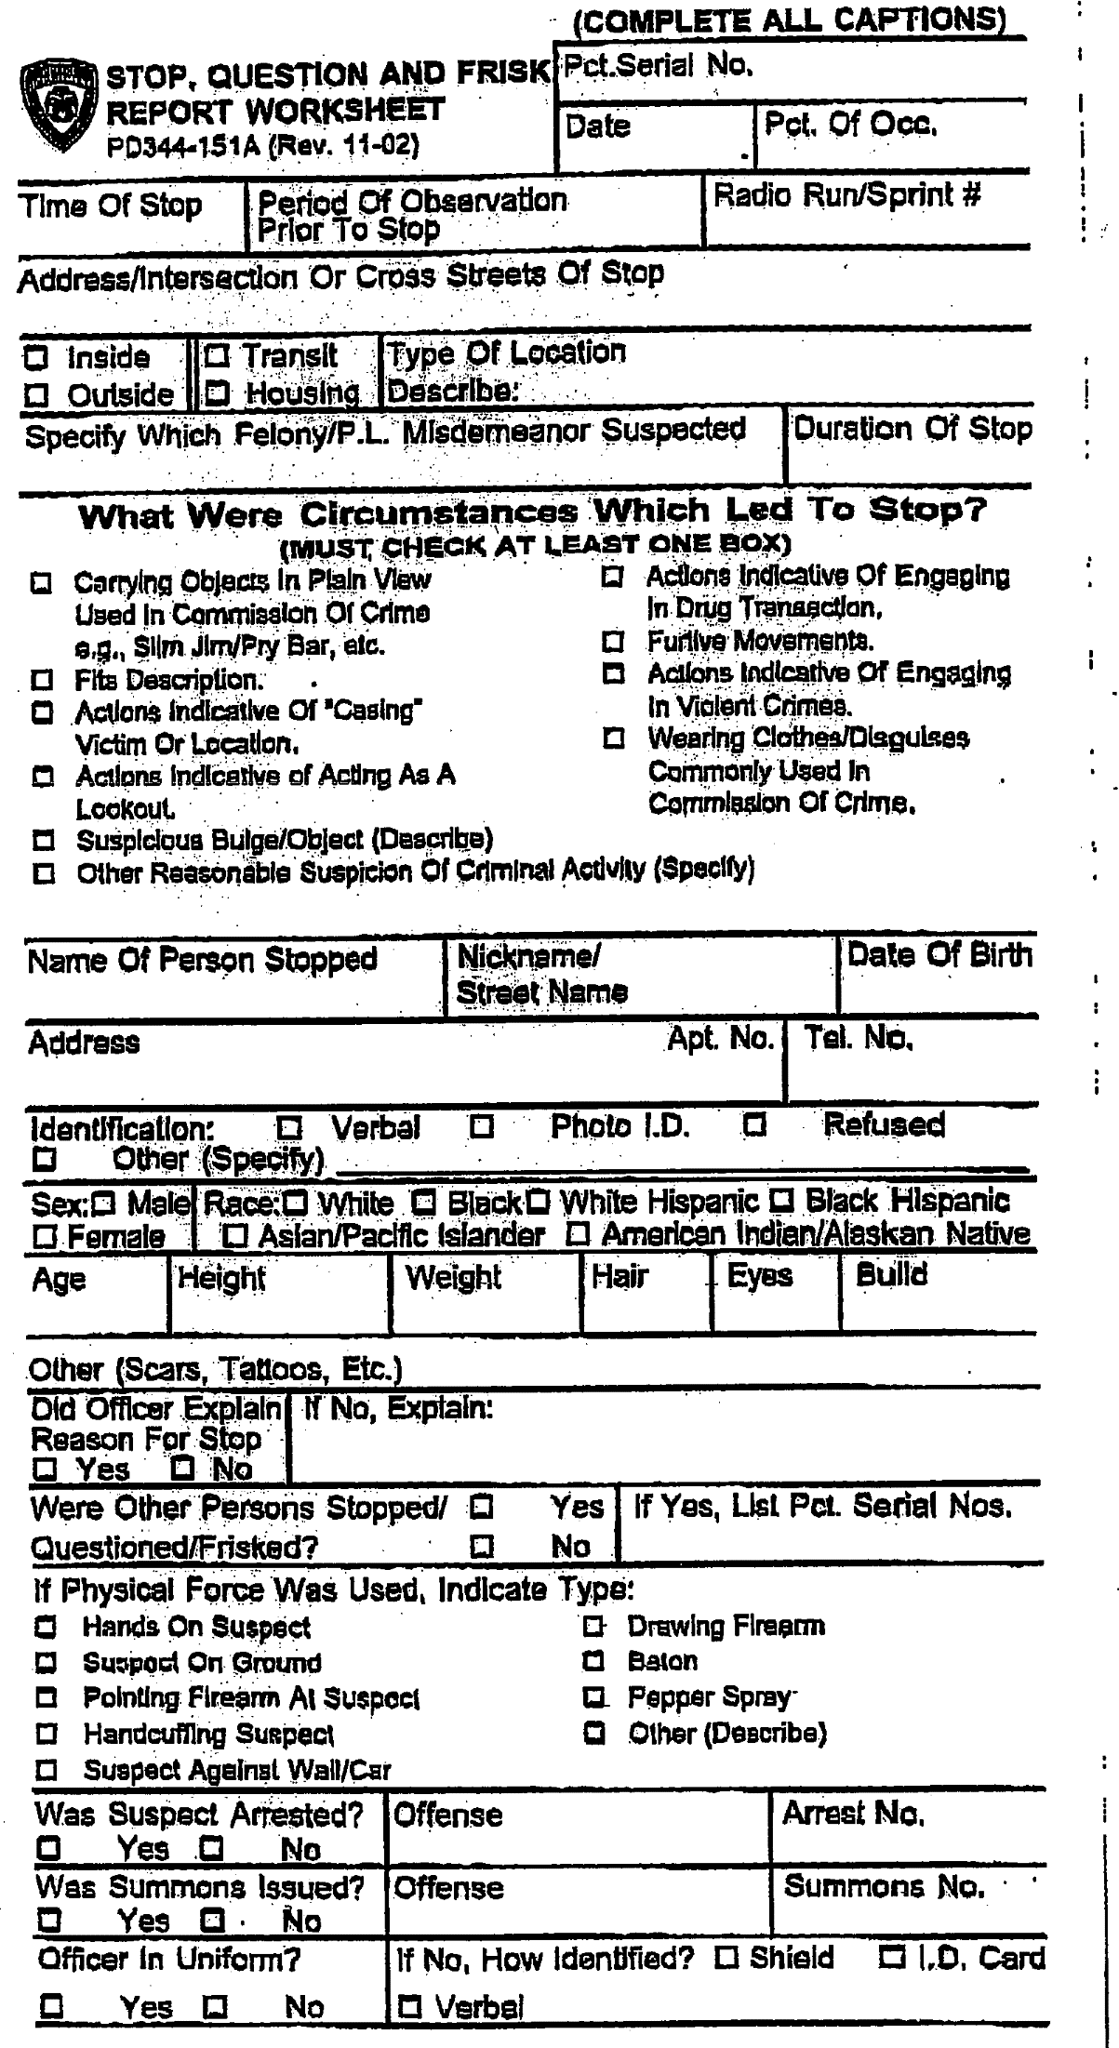
Introduction
The stop-question-and-frisk program, or stop-and-frisk, in New York City, is a New York City Police Department practice of temporarily detaining, questioning, and at times searching civilians on the street for weapons and other contraband.

Slide 3
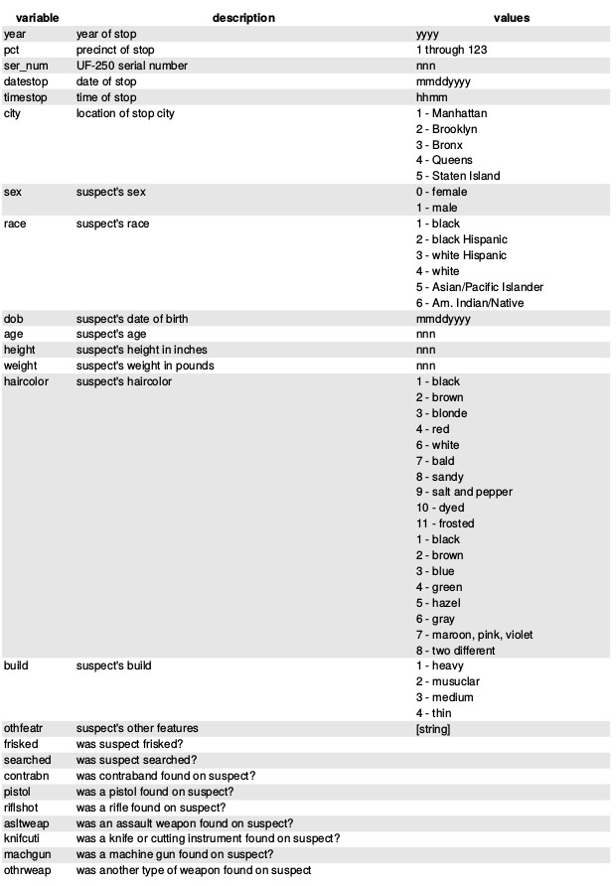
Model Variables
2014 data
45787 cases
112 variables

Slide 4
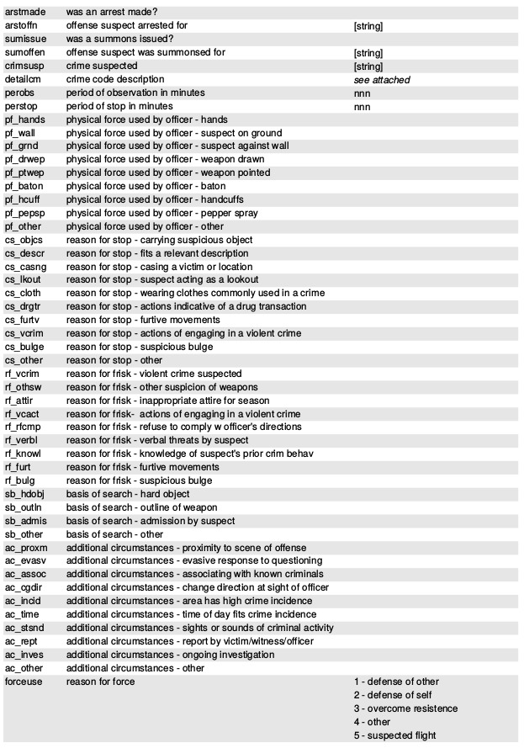
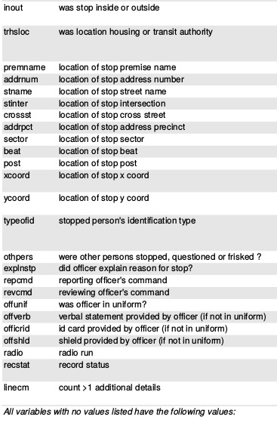
Model Variables

Slide 5

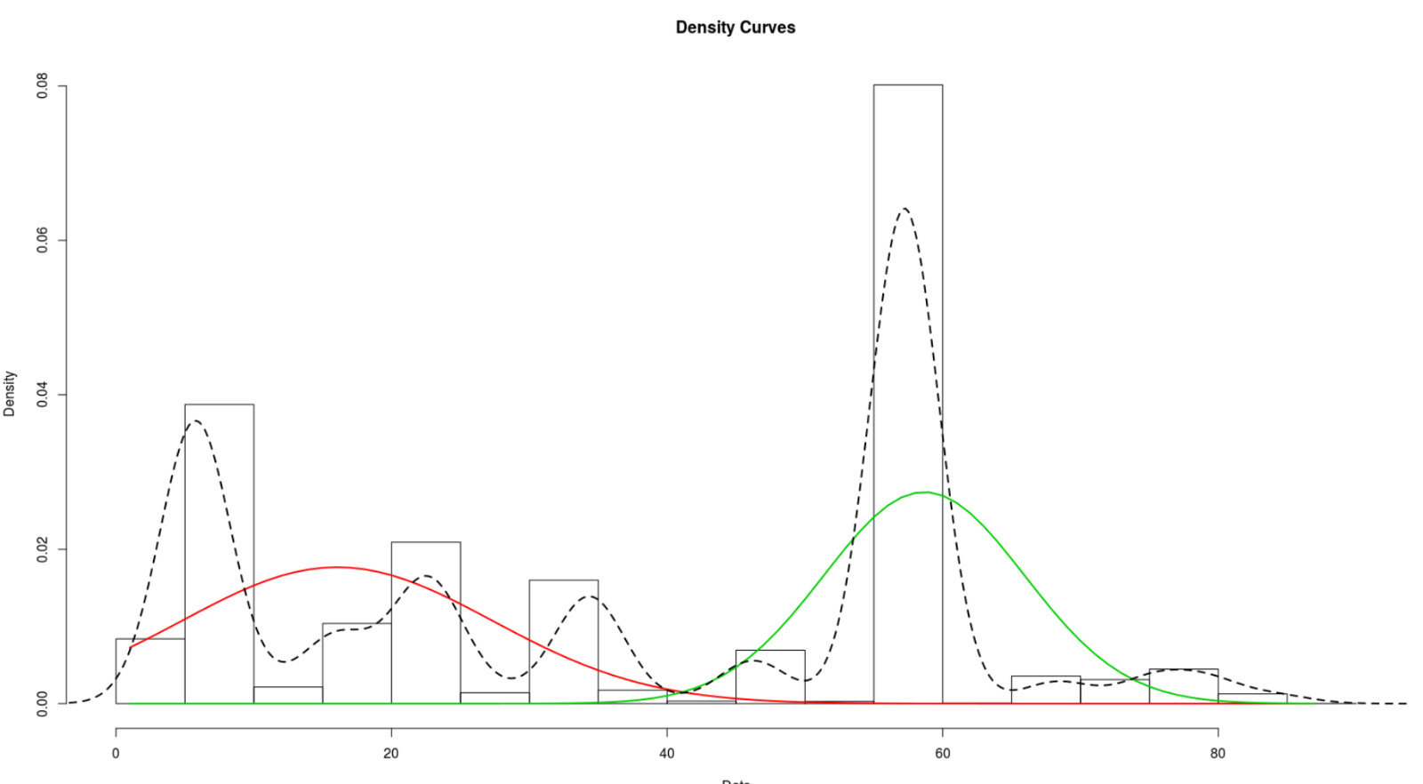
Target Variables
Variable arstmade
Variable Perstop

Slide 6
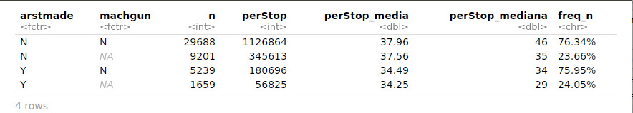
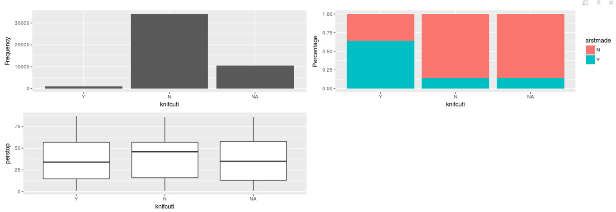
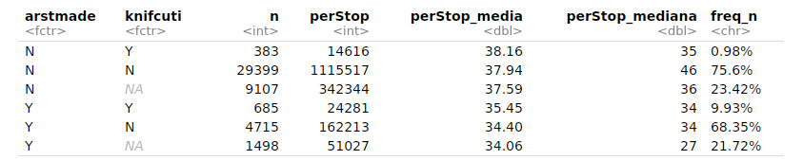
Exploratory Data Analysis

Slide 7
Methods
Regression type | Target Variable
Simple linear Regression | perstop
Multiple linear Regression | perstop
Logistic Regresión | arstmade
KNN | arstmade
Sistem of recomendation | arstmade
Decission Tree / Random Forest | arstmade

